Slide 1
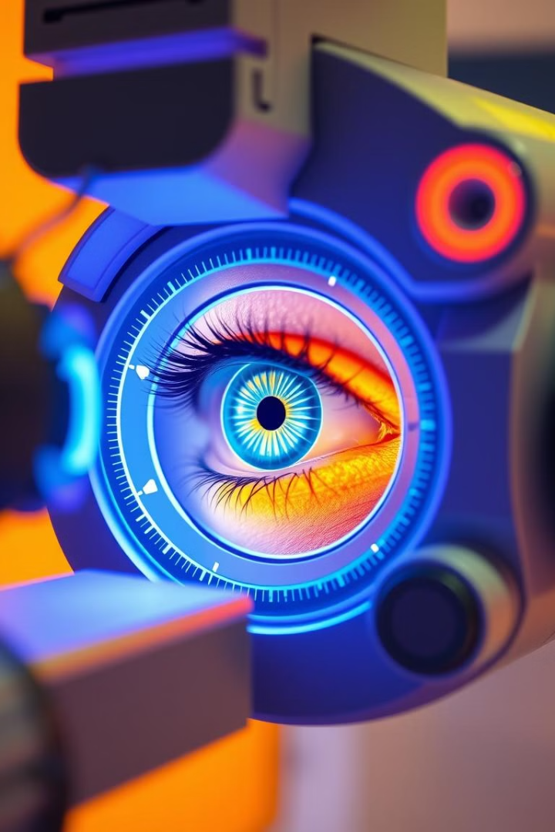
MEDI-SCAN: AI-Powered Ocular Disease Diagnosis
Revolutionizing eye care with AI-driven medical image analysis. Automated detection of cataract, glaucoma, diabetic retinopathy, and normality. Leveraging advanced machine learning & data visualization. Accurate, efficient, and accessible diagnostics.

Slide 2
Technology & Advantages
Advanced AI
Enhanced Analysis
Cost Effective
Deep learning models trained on retinal image datasets
Image enhancement & preprocessing for reliable analysis
Solution for mass screenings
Helps in underserved areas
Accuracy rates exceeding 95%
Results available in seconds

Slide 3
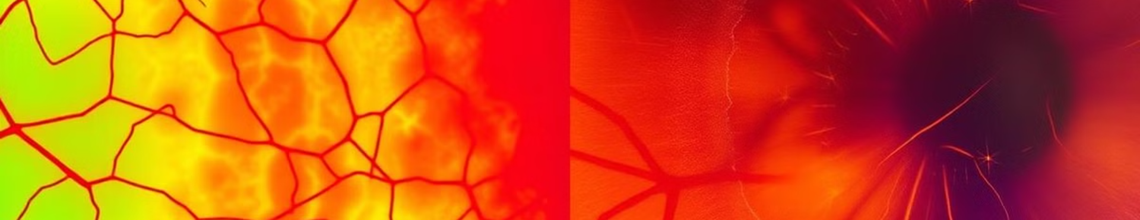




Targeted Ocular Diseases
Cataract
Glaucoma
Automated detection of lens opacity and severity grading
Analysis of optic nerve for early detection
Diabetic Retinopathy
Normality Assessment
Identification of microaneurysms, hemorrhages, and exudates
Ensures healthy eyes are accurately identified

Slide 4
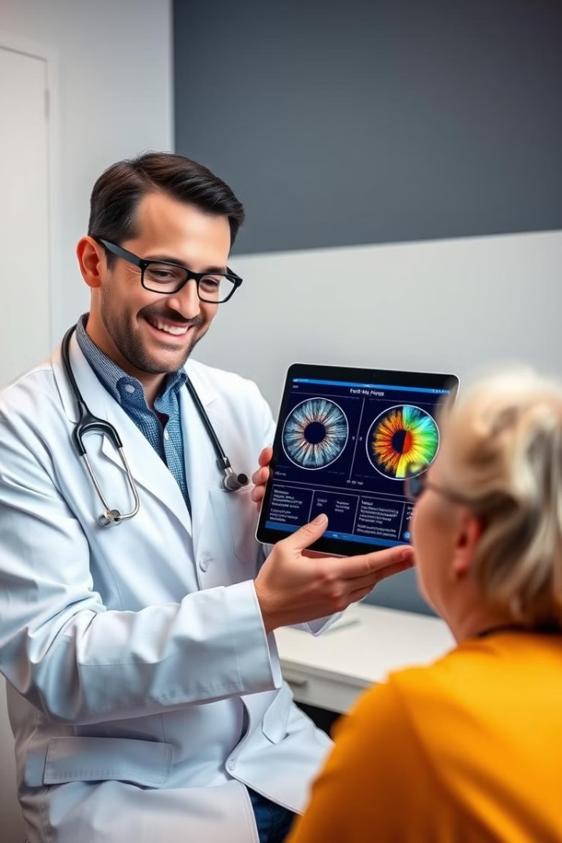
Conclusion
Transformative Approach
To ocular disease diagnosis
Improving Outcomes
Through early detection and intervention
Expanding Access
To quality eye care using cutting-edge technology

